Slide 1
Behaviour change techniques
Job code: INT-20-2100134 Date of preparation: August 2021

Slide 2
Disclaimer
CF CARE is funded entirely by Vertex Pharmaceuticals (Europe) Limited. The content has been prepared and developed by the steering committee with logistical and editorial support from the CF CARE secretariat, ApotheCom. Vertex has had an opportunity to review the content and tools for accuracy.

Slide 3
Introduction
These modules have been developed by a steering committee of international cystic fibrosis experts to cover motivational interviewing (MI) techniques, which can form an effective framework for improving patients’ openness to behavioural change
The MI content is organised into five modules, which are designed to provide you with the knowledge and skills to improve your individual practice of MI. All modules can be downloaded from www.cfcare.net
This module explores behaviour change techniques

Slide 4
Learning objectives
Recognise the importance of setting goals to assist patients in achieving personal outcomes that are significant to them
Understand how change plans can assist in managing the change process
Identify collaborative methods to write an effective change plan that is personal to the patient
Highlight the different behaviour change techniques that can assist a patient achieving their goals:
Problem solving
Implementation intention plans
Reinforcement

Slide 5
Introduction

Slide 6
When someone is ready to change…
Phase 1 goals
Raise the importance of change
Enhance confidence
Resolve ambivalence
The key question: what will you do next?
Phase 2 goals
Solidify the patient’s commitment to change
Negotiate a change plan

Slide 7
So they want to change...
What do you do?
Agree on a goal
Help them make a good plan
Look at the options for achieving the goal
Check that they are still committed
Image source: Pexels

Slide 8
Setting goals

Slide 9
Setting goals
Common mistake: wanting to do everything at once
You may need to be active in helping your patient set a realistic goal
Smaller and easier at first is best
Remember, within an empathic relationship, you can offer advice as long as it is provided with permission

Slide 10
Setting goals
Set SMART goals:
Specific
Measurable
Attainable
Relevant
Time-bound

Slide 11
Goals and targets
This will mean breaking up large goals into targets
Goal | Strategy | Target
Buy a house | Save for a deposit | Put aside X amount each month

Slide 12
Developing a change plan

Slide 13
Developing a change plan
Practitioners may need to be active
Guiding is very important at this point
Provide hints and tips based on experience with others (permission required)
This might entail a lot of discussion and negotiating
Always a good idea to write the plan down

Slide 14
Change plan: examples
What will I change?
What is my goal?
How am I going to achieve this?
Action I will take
When?
What (and who) can help?
What barriers might get in the way?
How will I deal with the barriers?

Slide 15
Writing a change plan

Slide 16
Hints on writing a change plan
Use SMART goals
Use strategies to create routine/cues:
Mobile phone alarms, stickers, pill organiser, placing medications in a location where they will be seen
Incorporate into existing routine and use daily activity as a cue (e.g. tooth brushing)
Use friends/family/partner as support and cues

Slide 17
Hints on writing a change plan
If you have concerns that a plan is too complex or not complex enough, offer advice (with permission)
“I wonder whether it might be helpful if I share some of the feedback I have received from other people in a similar position about what helped and what has not?”
“It feels like the plan is really coming together”

Slide 18
Two things that can go wrong...
You do not get started
You stop once you've started

Slide 19
What helps?
Draw up a different plan for each patient
Have an honest conversation about what is going to:
Help (allies, resources, motivation, etc.)
Hinder (possible obstacles)
Three useful techniques:
Problem-solving therapy¹
Implementation intention plans¹
Reinforcement^{2,3}
1. Arden MA, et al. Pilot Feasibility Stud. 2021;7:1; 2. Skinner BF. Science and Human Behavior. 1953:59–77; 3. Ernst MM, et al. Child Adolesc Psychiatr Clin N Am. 2010;19:263–283.

Slide 20
Behaviour change techniques:
1. Problem solving

Slide 21
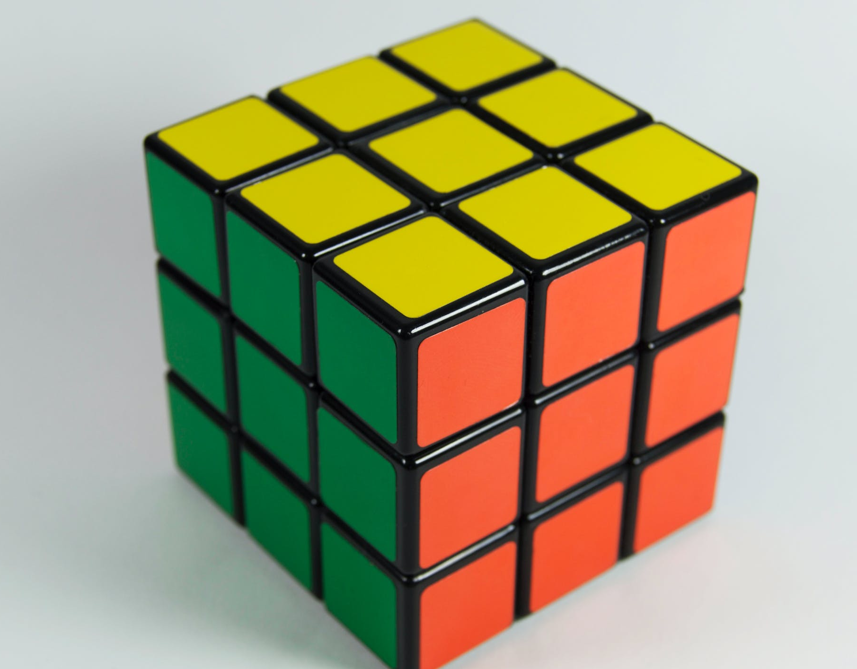
Problem solving
Considered a therapy in its own right¹
Used as a strategy for improving adherence^{1,2}
Image source: Pexels
1. Nezu AM, et al. Problem-Solving Therapy: A Treatment Manual. 2013:3; 2. Arden MA, et al. Pilot Feasibility Stud. 2021;7:1.

Slide 22
Problem solving
Clarify and define the problem to be solved
Set a realistic goal
Brain storming: generate multiple possible solutions
List pros and cons for each solution
Select the best and most feasible solution
Try it out
Evaluate the outcome

Slide 23
Behaviour change techniques:
2. Implementation intention plans

Slide 24
Implementation intention plans
Many people find it difficult to carry out their resolutions
For example, a meta-analysis found that 36% of people failed to follow through with their intentions of being active¹
How can you boost this figure?
Implementation intentions²
Developing implementation intentions can significantly improve goal striving on the spot
1. Rhodes RE, de Bruijn GJ. Br J Health Psychol. 2013;18:296–309; 2. Gollwitzer PM. Motiv Emot. 2014;38:305–322.

Slide 25
What are implementation intention plans?
They ‘translate goals into actions’
You anticipate obstacles
Work out how you will know if you hit an obstacle
Come up with a realistic and effective action plan for each of them
And write it down!

Slide 26
Writing down the implementation intention plans
Write these down in the following format:
If x happens, then I will do Y
e.g. “If I have a day when I do not do my nebs, then I will remind myself that no one is perfect, I can put that day down to experience – and maybe even learn from it – and carry on. It does not mean that I have failed”

Slide 27
Hints at writing implementation intention plans
Spotting obstacles
Discuss what happened when trying to change before
Imagine changing, look for roadblocks on the way
Imagine a typical day/week after changing
Increasing effectiveness
Vital they are written down but can re-write them/go over them every day
Put them in a visible place
Encourage patient to practise thinking them through so they become semi-automatic habits

Slide 28
Behaviour change techniques:
3. Reinforcement

Slide 29
Reinforcement
Reinforcement is more powerful than punishment, role models, etc.
Being healthier may not be enough of a reward (and it may take a while to materialise) so...
Smaller or materialistic reinforcements work well, i.e. complete a week and go shopping

Slide 30
Building in reinforcement
Encourage your patient to record how well they do
Use rewards to reinforce the change:
Make it clear what this is to be and when it will be earned
Keep a record!
Image source: Pexels

Slide 31
What else?
Use diaries to track change – design the diary and discuss the reward together
Use reinforcement – give yourself a treat if you do what you set out to do (we all respond to this)
Look for ways to make the new behaviour part of a routine
Link it to something already established
Involve others, etc.

Slide 32
Summary
Setting goals acknowledges a patients’ readiness to change and highlights a clear path to assist individuals to achieve their targets
Goals can be split into two phases:
Phase 1 – raise the importance of change and enhance an individual’s confidence to change
Phase 2 – solidify a patient’s commitment to change and negotiate a change plan
Writing a change plan helps manage the change process between a patient and their physician
Behaviour change techniques, such as problem solving, implementation intention plans and reinforcement, can be integrated into a change plan to assist in achieving a patient’s goal

Slide 33
References
Arden MA, Hutchings M, Whelan P, et al. Development of an intervention to increase adherence to nebuliser treatment in adults with cystic fibrosis: CFHealthHub. Pilot Feasibility Stud. 2021;7:1.
Ernst MM, Johnson MC, Stark LJ. Developmental and psychosocial issues in cystic fibrosis. Child Adolesc Psychiatr Clin N Am. 2010;19:263–283.
Gollwitzer P. Weakness of the will: Is a quick fix possible? Motiv Emot. 2014;38:305−322.
Nezu AM, Nezu CM, D’Zurilla TJ. Problem-Solving Therapy: A Treatment Manual. New York: Springer Publication Company. 2013.
Rhodes RE, de Bruijn GJ. How big is the physical activity intention-behaviour gap? A meta-analysis using the action control framework. Br J Health Psychol. 2013;18:296–309.
Skinner BF. Science and Human Behavior. New York: Macmillan. 1953.

